Slide 1
Improving usability of the“Late Add/ Drop” form
Team Infinite Loop
Abhishek, Chris, Harsh, Priyanshu and Vrishti

Slide 2
Aim
Test to identify problems in the original form
Create prototype through feedback from users
Usability testing on iterative prototypes
Create a more usable version of the form

Slide 3
Original Problems Identified
Instructions are very long
Users not reading instructions
Same type of field, different formats
Not much spacing between elements
Notes:
Instructions
Wall of text
Not actually read by lots of users
Parts were redundant
Alignment was not consistent
Formatting
Some parts were not clear what they actually were
Date sometimes uses __/__/__ and sometimes ______
Users not reading instructions
Related to the first problem
Also may not have known about instructions

Slide 4
Design Principles:
Focusing on spacing, alignment and clarity.
Highlighting the headings to create contrast.
Focusing on improving the design without changing much of the content.

Slide 5
Iteration Summary
First Iteration: A horizontal prototype making the Instructions column Concise.
Second Iteration: A prototype with design changes in the first page. Improving spacing, making sections clearer with headings, alignment of text, enclosure and order.
Third Iteration: Changes in the content- reduced redundancies, homogenous design for “date” and contrast incorporated in the headings, especially- “Read Instructions First”.

Slide 6
Research Questions and Methodologies used
Will reducing the length of the “Instructions” column while keeping it exhaustive, makes this form more usable?
Will applying principles of design like enclosure, alignment and spacing on the content of this form, create a positive impact on its usability?
How can we make the form more concise and simple while still keeping as many accessibility elements as we can?
Talk Aloud
One on one talk aloud
Focus Group

Slide 7
Methodologies used
Talk-aloud
Focus Group
One-on-One talk-aloud
Notes:
Talk aloud- In this test we asked the participants to use the form while continuously thinking out loud — that is, simply verbalizing their thoughts as they move through the form.In this method we posed several questions to the users while filling out the form. One-on-one talk-aloud
It allowed us to gently guide them to get their thoughts on the elements we were most interested in.
We did focus on not tainting the results by guiding them too much.

Slide 8
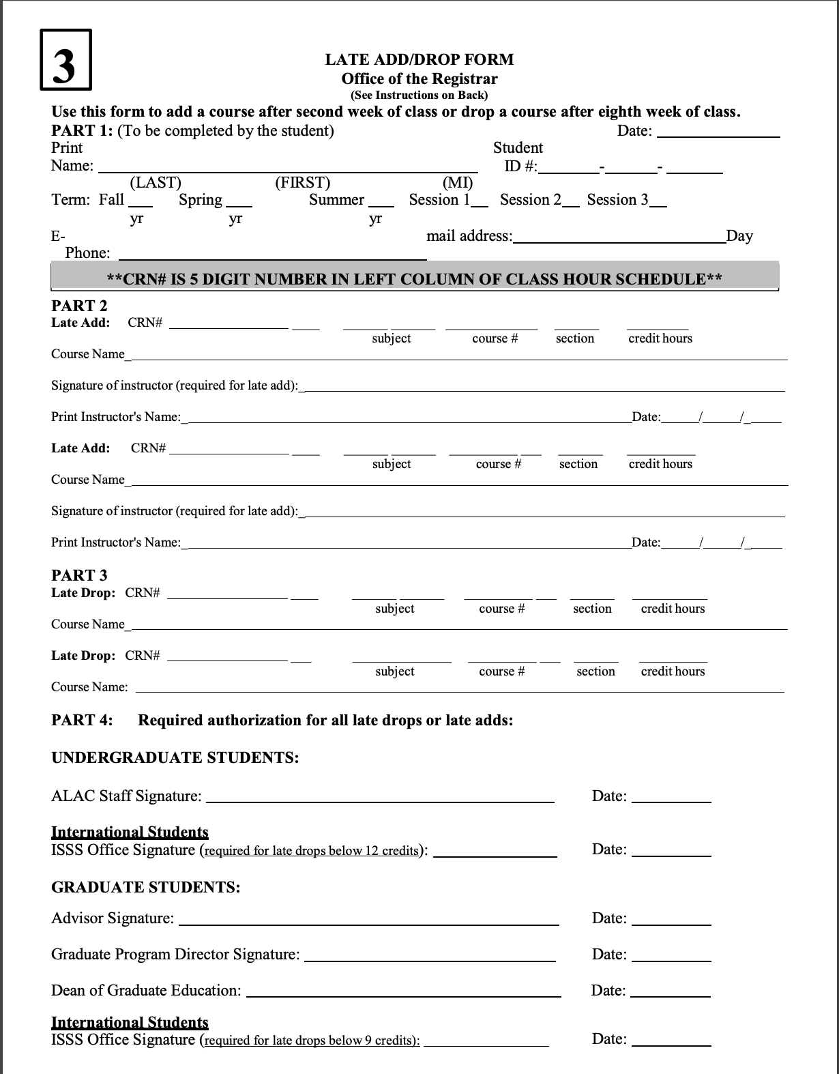
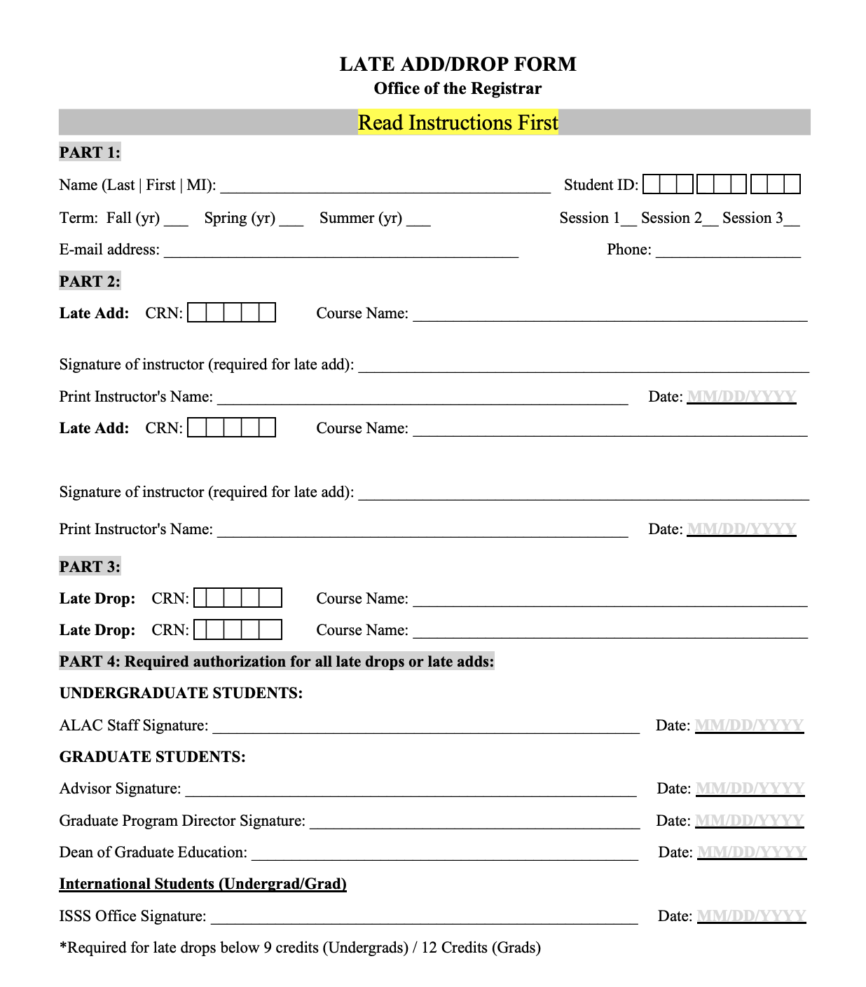
Old
New

Slide 9
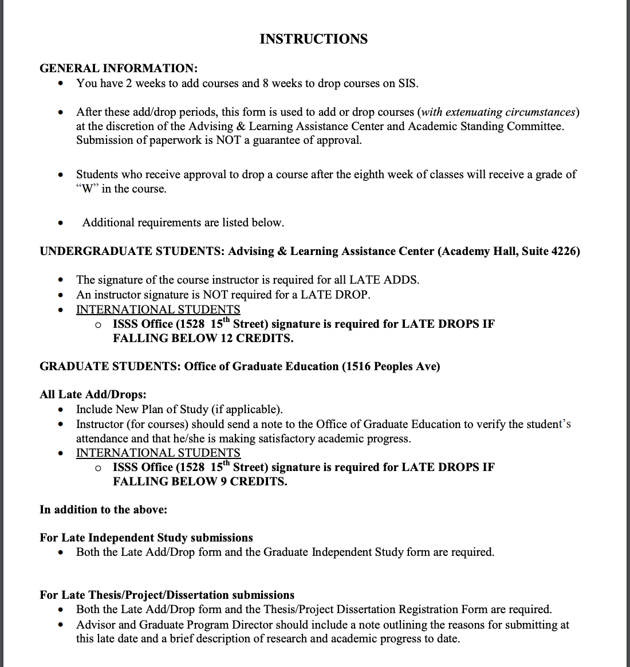
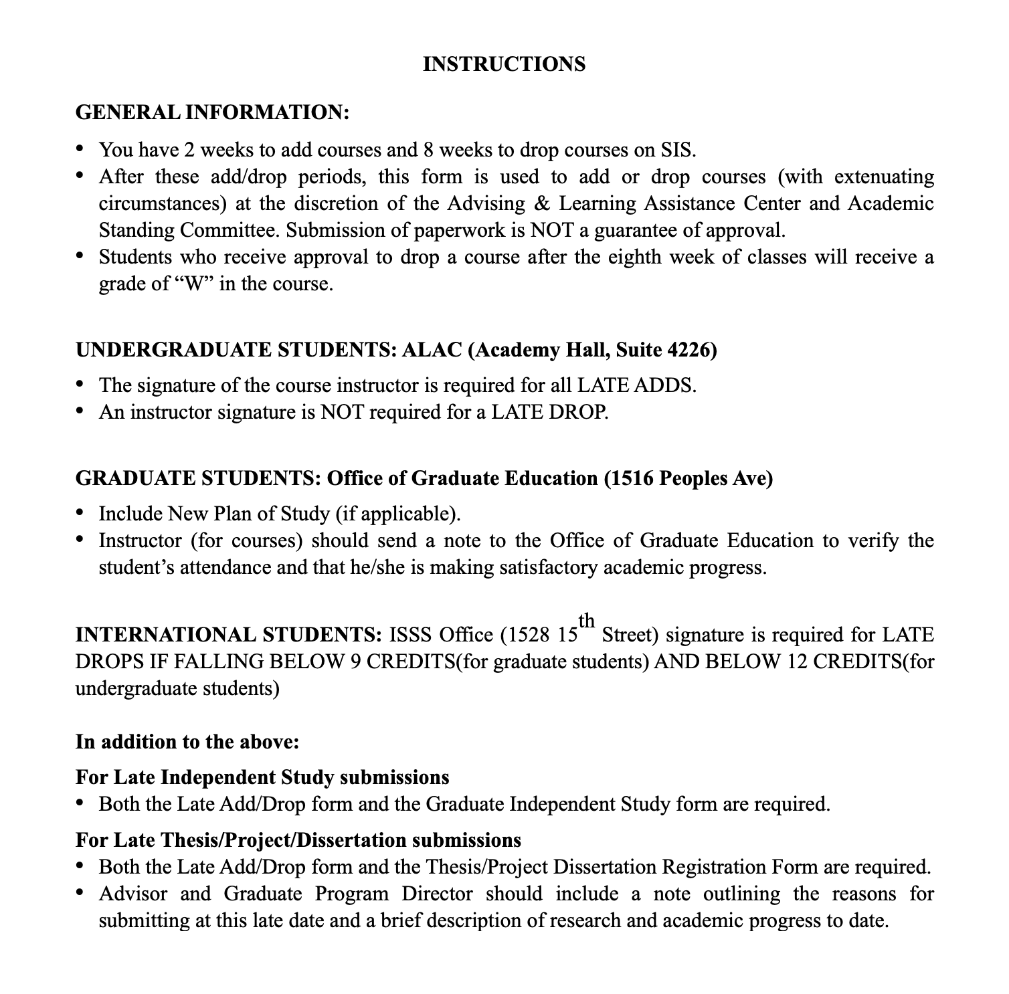
Old
New

Slide 10
Changes made
Making instructions more concise
Adjusting headings, alignment, and spacing
Adding enclosure and order
Design consistency
Emphasizing important areas

Slide 11
Feedback on the New Version
Better reading and comprehension
More readable and aesthetically pleasing
Consistency in date forms
No duplication of fields

Slide 12


